Slide 1
Module 6
Configuring and managing message transport
Notes:
Presentation: 90 minutes
Lab: 50 minutes
After completing this module, students will be able to:
Describe message transport.
Configure message transport.
Manage transport rules.
Required materials
To teach this module, you need the Microsoft PowerPoint file 20345-1A_08.pptx.
Preparation tasks
To prepare for this module, you should:
Read all of this module’s materials.
Practice performing the demonstrations and labs.
Work through the Module Review and Takeaways section to determine how you will use the information to reinforce student learning and promote knowledge transfer to on-the-job performance.
As you prepare for this class, it is imperative that you complete the labs yourself. This gives you an understanding of how the labs work and the concepts that each covers, so that you can provide meaningful hints to students who might have issues. Furthermore, it will help guide your lecture to ensure that you discuss the concepts that the labs cover.
20345-1A
8: Configuring and managing message transport

Slide 2
Module Overview
Overview of message transport Configuring message transport Managing transport rules
Notes:
20345-1A
8: Configuring and managing message transport

Slide 3
Lesson 1: Overview of message transport
Message transport components How does message routing work? Options for modifying the default message flow What are transport agents? Tools for troubleshooting SMTP message delivery Demonstration: Troubleshooting SMTP message delivery
Notes:
Question
You can place messages directly into the submission queue for processing.
( )False
( )True
Answer
(√)False
( )True
Question
You have recently implemented Exchange Server 2016 for your organization, and the users have been very pleased with the service until today. Today email seems to be flowing slowly through the Exchange organization and in from the Internet. You haven’t made any changes to the Exchange servers. What is the most likely cause of the slowdown?
Answer
The most likely cause of the slowdown is back pressure due to resource shortages. Even though you have not made any changes, Exchange 2016 continues to use resources. In some cases, the resource utilization is temporary during a busy period. However, many new implementations have a high volume of logging information that is stored in the installation directories. If the installation directories are stored on the same drive as the transport queues, this often causes back pressure that slows down message processing due to a shortage of free disk space. To avoid this, host transport queues on their own disk, and monitor disk utilization.
20345-1A
8: Configuring and managing message transport

Slide 4
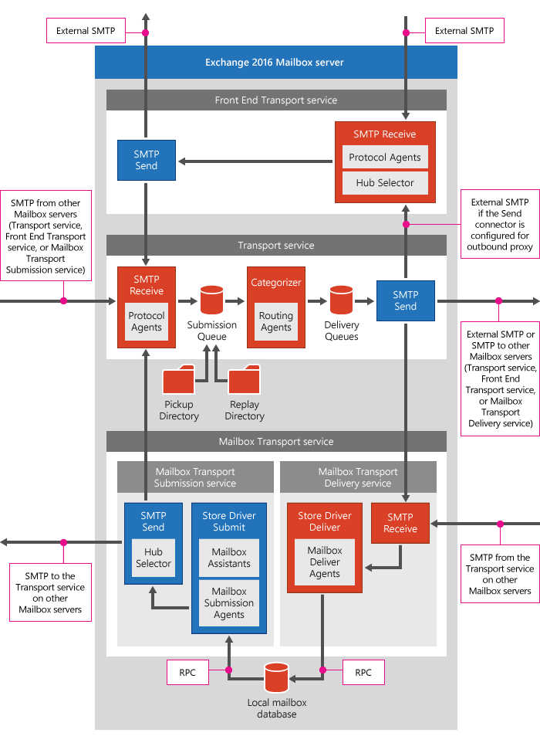
Message transport components
Notes:
There are four slides for this topic.
Use the graphic on the slides to describe different mail flow scenarios, such as:
Sending messages to a mailbox on the same server.
Sending messages to a mailbox on a different server.
Sending messages to the Internet.
Receiving messages from the Internet.
Limit your discussion to message delivery within a single site. The next topic on message routing addresses message delivery between sites.
20345-1A
8: Configuring and managing message transport

Slide 5
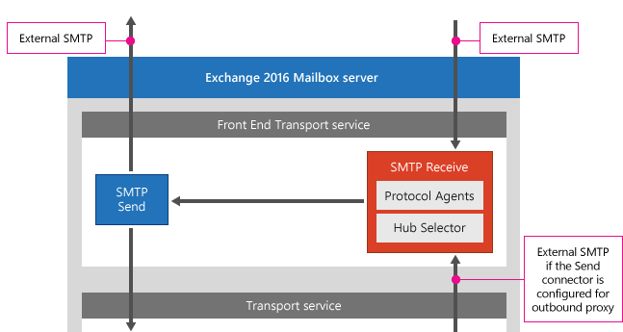
Message transport components (continued)
Notes:
Review the detail of the front-end transport service.
20345-1A
8: Configuring and managing message transport

Slide 6
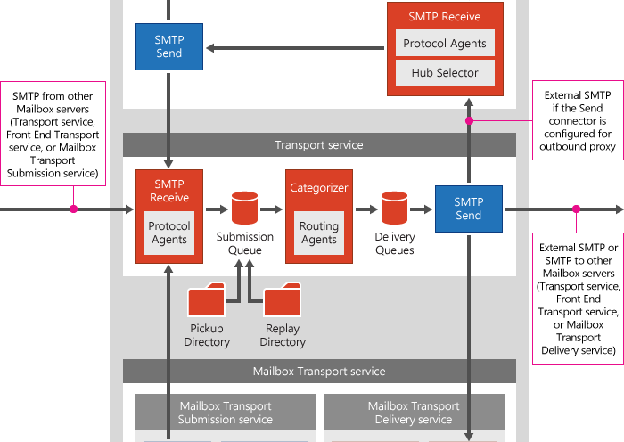
Message transport components (continued)
Notes:
Review the transport service detail.
20345-1A
8: Configuring and managing message transport

Slide 7
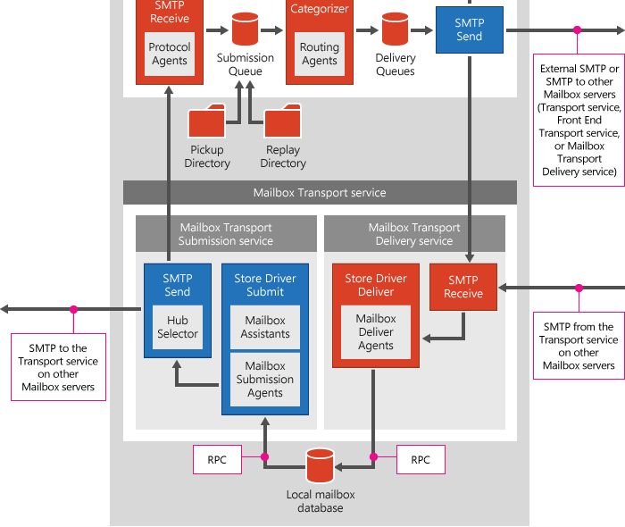
Message transport components (continued)
Notes:
Review the mailbox transport service detail.
20345-1A
8: Configuring and managing message transport

Slide 8
How does message routing work?
Routing destinations:
Mailbox database
Connector
Distribution group expansion server
Delivery groups:
Routable DAG
Mailbox delivery group (Exchange Server 2013, 2016 and 2019)
Mailbox delivery group (Exchange Server 2010)
Connector source server
Server list
AD DS site
Notes:
If your students have experience with Exchange Server 2013, note that the routing in Exchange Server 2016 is similar. If your students have experience with Exchange 2010, be sure to highlight the following differences:
Routable DAG did not exist in Exchange Server 2010. Exchange Server 2010 used the AD DS site as a routing boundary regardless of DAG membership.
Exchange Server 2013 and Exchange Server 2016 can deliver directly to each other within an AD DS site. Exchange Server 2010 must deliver messages to a Transport service or other Exchange Server version for delivery.
If you have time consider drawing a diagram on a whiteboard to show the delivery process.
20345-1A
8: Configuring and managing message transport

Slide 9
Options for modifying the default message flow
Default message flow:
Least-cost route is calculated
Messages are sent directly to destination
Modification | Description
Fallback | When direct delivery fails the next closest AD DS site is used
Hub site | All messages are delivered to a hub site on the least-cost path
Exchange specific routing costs | Exchange-specific costs are used for calculating the least-cost path
Expansion server for distribution group | Messages are delivered to the expansion server to identify the final recipients
Notes:
There are two slides for this topic.
Ensure that students understand that the default delivery process delivers messages directly to the remote delivery group even though a least-cost route is calculated. This is counterintuitive for most students. Then discuss when that process is not true.
20345-1A
8: Configuring and managing message transport

Slide 10
Options for modifying the default message flow
Source site
20
10
10
Default message flow
20
10
Destination site
Notes:
Use this slide to show and discuss with students how the default message flow can be modified.
20345-1A
8: Configuring and managing message transport

Slide 11
What are transport agents?
Transport agents process message that pass through the Transport service
Most transport agents are not visible to management cmdlets
Custom transport agents:
May be installed by other add-on software
Can be developed by you
View all enabled transport agents:
Get-TransportPipeline | FL Event,TransportAgents
Notes:
Students should understand what a transport agent is because that knowledge aids them in understanding how journaling and transport rules work. However, you can tell students that generally, you do not manually modify transport agents.
Additional Reading: For additional information about creating custom transport agents see How to write an Exchange 2013 transport agent: http://aka.ms/l1sxqx.
20345-1A
8: Configuring and managing message transport

Slide 12
Tools for troubleshooting SMTP message delivery
You can use the following tools to troubleshoot message delivery:
Queue Viewer
Delivery Reports
Message tracking logs
Protocol logging
Telnet
Remote Connectivity Analyzer website
Notes:
Describe each of these tools and you might use them.
20345-1A
8: Configuring and managing message transport

Slide 13
Demonstration: Troubleshooting SMTP message delivery
In this demonstration, you will see how to use SMTP troubleshooting tools
Notes:
The most common problem with viewing delivery reports is connecting to Exchange Administrative Center (EAC) by using localhost. If you connect to EAC by using localhost then viewing delivery reports fails. The desktop shortcut and Start item for EAC created by Exchange Server 2016 installation use localhost in the connection URL.
After completing the demonstration, leave all virtual machines running for the next demonstration.
Preparation Steps
For this demonstration, use the available virtual machine environment. Before you begin the demonstration, complete the following steps:
On the host computer, click Start, point to Administrative Tools, and then click Hyper-V Manager.
In Hyper-V Manager, click 20345-1A-LON-DC1, and then in the Actions pane, click Start.
In the Actions pane, click Connect. Wait until the virtual machine starts.
Sign in by using the following credentials:
User name: Administrator
Password: Pa$$w0rd
Domain: Adatum
Repeat steps 2 through 4 for 20345-1A-LON-EX1.
Repeat steps 2 through 4 for 20345-1A-LON-EX2. You do not need to use this server, but it must be online.
Demonstration Steps
On LON-EX1, click Exchange Toolbox.
In the Toolbox pane, double-click Queue Viewer.
Note: Explain that the Queue Viewer tool looks into the local-server message queues. Therefore, you will see immediately if a message is not delivered correctly. It is helpful to have a mail message in the queue so that you can show the students both the error message and the properties, such as retry.
20345-1A
8: Configuring and managing message transport
(More notes on the next slide)

Slide 14
Lesson 2: Configuring message transport
Configuring message transport options Demonstration: Configuring transport settings Configuring SMTP domains Demonstration: Configuring accepted and remote domains What is an SMTP connector? Demonstration: Configuring SMTP send and receive connectors What is message moderation? What is message journaling?
Notes:
Question
Your organization, A. Datum, has recently purchased a competitor named Contoso. Until Contoso's IT organization can be merged with yours, the email domain for Adatum.com needs to be used for both Exchange organizations. Which type of domain should be configured in your organization to allow email addresses for adatum.com to exist in both organizations?
( )Option 1: Remote domain
( )Option 2: Accepted domain
( )Option 3: Internal relay domain
( )Option 4: External relay domain
( )Option 5: Authoritative domain
Answer
Option 3
An internal relay domain is one that has mailboxes in the local Exchange organization and a remote email system. If the recipient is not in the local Exchange organization, then the message is delivered through a send connector to the remote email system.
Question
You have just completed an installation of Exchange Server 2016 for your organization. The send and receive connectors are using the default maximum message sizes of 35 MB. However, when you attempt to send a message with a 15 MB attachment, you get an error indicating that the message is too large. What is the most likely reason that the message is being blocked?
Answer
The message size limits in the Exchange transport pipeline must all be large enough to accommodate the message size. At the organizational level, the default maximum message size is 10 MB. You should increase this to 35 MB to match the send and receive connectors.
20345-1A
8: Configuring and managing message transport

Slide 15
Configuring message transport options
View and set organization-wide transport settings by using:
EAC
Get-TransportConfig
Set-TransportConfig
You can set options such as:
Maximum message sizes
Maximum number of recipients
Postmaster address
Shadow redundancy settings
SafetyNet settings
Notes:
Controlling maximum message sizes is a common task in many organizations. Ensure that students understand that in addition to increasing the maximum message size with Set-TransportConfig, they might also need to increase the maximum message sizes in send and receive connectors.
20345-1A
8: Configuring and managing message transport

Slide 16
Demonstration: Configuring transport settings
In this demonstration, you will see how to configure transport settings
Notes:
After completing the demonstration, leave all virtual machines running for the next demonstration.
Preparation Steps
To perform this demonstration, ensure that the 20345-1A-LON-DC1, 20345-1A-LON-EX1, and 20345-1A-LON-EX2 virtual machines are running. Sign into all virtual machines using the Adatum\Administrator account with the password Pa$$w0rd. These should still be running from the previous demonstration.
Demonstration Steps
On LON-EX1, on the taskbar, click Exchange Management Shell.
In EMS, type Get-TransportConfig, and press Enter.
Scroll through the data displayed to provide a quick overview of the settings.
Type Get-TransportConfig | FL *max*, and press Enter.
Specifically point out the values for MaxRecieveSize, MaxRecipientEnvelopeLimit, and MaxSendSize.
Type Set‑TransportConfig ‑MaxSendSize 20MB ‑MaxReceiveSize 20MB, and press Enter.
Close EMS.
In EAC, click mail flow, and then click the receive connectors tab.
Click More, and then click Organization transport settings.
In the organization transport settings window, note that the limits tab contains the settings defined in EMS.
Click the delivery tab, and in the Specify the external postmaster address box, type postmaster@adatum.com and click Save.
Close EAC.
20345-1A
8: Configuring and managing message transport

Slide 17
Configuring SMTP domains
Accepted domains define SMTP domains for which the Exchange organization will accept messages:
Authoritative
Internal relay
External relay
Remote domains define message settings for external organizations:
Out-of-office messages
Automatic replies and forwarding
Message format
Notes:
Explain accepted domains and which types of accepted domains exist. Point out the difference among these three types, especially between internal and external relay domains. Also introduce remote domains and explain their purpose. Note that you can create new accepted domains in the EAC, but you must use Exchange Management Shell to create and manage remote domains.
20345-1A
8: Configuring and managing message transport

Slide 18
Demonstration: Configuring accepted and remote domains
In this demonstration, you will see how to configure accepted and remote domains
Notes:
Remind students that remote domains are accessible only in EMS.
After completing the demonstration, leave all virtual machines running for the next demonstration.
Preparation Steps
To perform this demonstration, ensure that the 20345-1A-LON-DC1, 20345-1A-EX1, and 20345-1A-LON-EX2 virtual machines are running. Sign into all virtual machines using the Adatum\Administrator account with the password Pa$$w0rd. These should still be running from the previous demonstration.
Demonstration Steps
On LON-EX1, open Internet Explorer, in the address bar, type https://LON-EX1.Adatum.com/ecp, and then press Enter.
Sign in to the EAC as Adatum\Administrator with the password Pa$$w0rd.
In EAC, click mail flow and click the accepted domains tab.
Click New.
In the new accepted domain window, in the Name box, type Tailspintoys, and in the Accepted domain box, type tailspintoys.com.
Click Internal Relay: Email is delivered to recipients in this Exchange organization or relayed to an email server at another physical or logical location.
Click Save.
On LON-EX1, on the taskbar, click Exchange Management Shell.
In EMS, type Get-RemoteDomain, and press Enter. Ensure that you have only one remote domain with DomainName “*”. Explain that this covers all domains.
Type New-RemoteDomain –Name Contoso –DomainName Contoso.com, and press Enter.
Type Get-RemoteDomain Contoso | FL, and press Enter.
Review the settings for the Contoso remote domain.
20345-1A
8: Configuring and managing message transport
(More notes on the next slide)

Slide 19
What is an SMTP connector?
SMTP connectors define settings for inbound and outbound SMTP connections
There are no default send connectors
Default Receive Connector | Port
Default FrontEnd ServerName | 25
Default ServerName | 2525
Client FrontEnd ServerName | 587
Client Proxy ServerName | 465
Outbound Proxy FrontEnd ServerName | 717
Notes:
Ensure that students understand the purpose of send and receive connectors and why they are necessary for message reception and delivery. Spend a few minutes talking about how a receive connector is selected. One of the most common mistakes Exchange administrators make is incorrect configuration of receive connectors.
20345-1A
8: Configuring and managing message transport

Slide 20
Demonstration: Configuring SMTP send and receive connectors
In this demonstration, you will see how to configure send and receive connectors
Notes:
Be sure you explain to students the difference between accepting anonymous connections with anonymous authentication and an anonymous relay. Accepting anonymous connections allows unauthenticated connections to deliver messages to the Exchange organization. An anonymous relay allows unauthenticated connections to deliver messages to anywhere through the Exchange organization. Allowing anonymous users in this demonstration only allows delivery to users in the Exchange organization. In the lab, students will configure a receive connector that allows anonymous relaying for an application server.
If time permits, consider using Get-SendConnector and Get-ReceiveConnector to view attributes that are not visible in Exchange admin center.
After completing the demonstration, leave all virtual machines running for the next demonstration.
Preparation Steps
To perform this demonstration, ensure that the 20345-1A-LON-DC1, 20345-1A-LON-EX1, and 20345-1A-LON-EX2 virtual machines are running. Sign into all virtual machines using the Adatum\Administrator account with the password Pa$$w0rd. These should still be running from the previous demonstration.
Demonstration Steps
On LON-EX1, on the taskbar, click Exchange Management Shell.
In EMS, type New-SendConnector –Name “Send to Internet” –AddressSpace * -SourceTransportServers LON-EX1,LON-EX2, and press Enter. Explain to the students that this creates a connector to send messages to the Internet.
Open Internet Explorer, in the address bar type https://LON-EX1.Adatum.com/ecp, and then press Enter.
Sign in to the EAC as Adatum\Administrator with the password Pa$$w0rd.
In EAC, click mail flow, and click on the send connectors tab.
Ensure that the connector is created, and then select it and click Edit.
Show options that are configured on this connector. Point out that proxy through Client Access server is not selected.
Click Cancel.
20345-1A
8: Configuring and managing message transport
(More notes on the next slide)

Slide 21
LAB 7 – Übung 1

Slide 22
What is message moderation?
Messages matching specific criteria must be approved before delivery
For distribution groups:
Define moderators
Define senders that do not require moderation
With transport rules:
Message matching a set of criteria are moderated
Each rule can specify different moderators
Multiple rules can be used to require an approval chain
Notes:
Ensure that students understand that two distinct mechanisms exist for implementing message moderation. Moderation can be implemented on specific recipients or by using transport rules.
20345-1A
8: Configuring and managing message transport

Slide 23
What is message journaling?
Journaling retains messages for compliance:
Journal reports are sent to a journaling mailbox
Standard journaling
Premium journaling
Journal rules contain:
Scope
Journal recipients
Journaling mailbox
Journaling mailboxes:
Should be separate from other mailboxes
Require large amounts of storage
Should have limited access
Notes:
Compare standard and premium journaling for the students. Be sure to highlight the differences between them, including the requirements for Exchange Enterprise client access licenses when using premium journaling. Also explain the considerations for journaling mailboxes.
20345-1A
8: Configuring and managing message transport

Slide 24
Lesson 3: Managing transport rules
What are transport rules? How do transport rules work? Configuring transport rules Demonstration: Configuring and using transport rules What are data loss prevention policies? Demonstration: Configuring and using a data loss prevention policy
Notes:
Question
By implementing DLP policies, you can guarantee that sensitive information is never sent outside your organization.
( )False
( )True
Answer
(√)False
( )True
Question
Your organization is planning to implement a standard signature for all email messages that are sent outside the organization. This signature needs to include user-specific information, company information, and a disclaimer. This signature needs to be applied regardless of the email client used. What is the simplest way to implement this for all users?
( )Option 1: Create a snippet of HTML for users to copy and customize in Outlook.
( )Option 2: Create one transport rule for each user that applies the appropriate signature.
( )Option 3: Create a single transport rule that uses variables to customize a disclaimer added to the messages.
( )Option 4: Purchase non-Microsoft software with a transport agent that adds customized signatures to messages.
( )Option 5: This is not possible.
Answer
Option 4
The simplest way to implement customized signatures is by implementing a non-Microsoft product that is designed for the task. These products implement a transport agent to process each message and add the appropriate signature. It is also possible to build transport rules with disclaimers and variables, but this is a relatively complex option by comparison.
20345-1A
8: Configuring and managing message transport

Slide 25
What are transport rules?
Transport rules restrict message flow or modify message contents when message are in transit
Common uses for transport rules are:
Disclaimers
Redirecting messages for inspection before delivery
Restrict messages based on content
Restrict messages based on classification
Notes:
Mention that a disclaimer is a common use for transport rules. You can also add a blind carbon copy (BCC) entry to messages matching the conditions of a transport rule to send a copy of a message to a specific mailbox. Adding a BCC entry is similar to journaling, but it might not meet compliance standards because the original email is modified.
20345-1A
8: Configuring and managing message transport

Slide 26
How do transport rules work?
Transport rules:
Are stored in AD DS
Are applied by all Exchange servers
Are applied to all messages
Multiple transport rules can apply to a single message
Notes:
Explain the storage of transport rules and how they are applied.
20345-1A
8: Configuring and managing message transport

Slide 27
Configuring transport rules
Transport Rule Component | Description
Conditions | Specify which message attributes are used to identify the message to act upon
Actions | Specify what is to be done to the selected messages
Exceptions | Specifies message attributes that define messages that are not acted upon
When multiple conditions are defined, all must be met
When multiple exceptions are defined, only one must be met
Notes:
As you describe the components that make up a transport rule, provide examples of some configuration options for each component. Some examples are:
Conditions. Search for message sender or recipient, keywords in the message’s subject or body, regular patterns such as customer numbers and social insurance numbers, and other specific items.
Actions. Block the message, send the message to an alternative address, add a disclaimer to the message, and other actions.
Exceptions. This list is similar to the conditions list, and it enables you to narrow down the conditions under which Exchange Server applies the actions.
20345-1A
8: Configuring and managing message transport

Slide 28
Demonstration: Configuring and using transport rules
In this demonstration, you will see how to create a transport rule
Notes:
After completing the demonstration, leave all virtual machines running for the next demonstration.
Preparation Steps
To perform this demonstration, ensure that the 20345-1A-LON-DC1, 20345-1A-EX1, and 20345-1A-LON-EX2 virtual machines are running. Sign into all virtual machines using the Adatum\Administrator account with the password Pa$$w0rd. These should still be running from the previous demonstration.
Demonstration Steps
On LON-EX1, open Internet Explorer, in the address bar, type https://LON-EX1.Adatum.com/ecp, and then press Enter.
Sign in to the EAC as Adatum\Administrator with the password Pa$$w0rd.
In EAC, click mail flow, and click the rules tab.
Click New, and then click Create a new rule.
In the new rule window in the Name box, type Test Transport Rule.
In the Apply this rule if drop-down box, select The subject or body includes.
In the specify words or phrases window, in the text box, type password, click the + sign, and then click OK.
In the new rule window, in the Do the following drop-down box, select Redirect the message to.
In the Select Members window, select Administrator, and click add->. Then click OK.
Ensure that Enforce is selected.
Click More options and describe the additional options.
Click Save.
On LON-DC1, open Internet Explorer, in the address bar type https://LON-EX1.Adatum.com/owa, and then press Enter.
Sign in to OWA as Adatum\Alex with the password Pa$$w0rd.
20345-1A
8: Configuring and managing message transport
(More notes on the next slide)

Slide 29
LAB 7 – Übung 2

Slide 30
What are data loss prevention policies?
DLP policies prevent sensitive information from being transmitted outside the organization
Methods to implement DLP policies:
Use templates from Microsoft
Use policies from a non-Microsoft vendor
Create custom policies
Policy Tips notify users of policy violations before sending a message
Document fingerprinting identifies documents matching a template
You can enforce or test DLP policies and rules
Notes:
Explain the scenarios in which data loss prevention (DLP) policies are useful. Explain how these policies are different from standard transport rules, and how they are similar to transport rules. Provide some examples for predefined policies, and discuss how you can import or create your own policy.
DLP policies were available in Exchange Server 2013, but they have been expanded with new sensitive information types, conditions, and actions.
20345-1A
8: Configuring and managing message transport

Slide 31
Demonstration: Configuring and using a data loss prevention policy
In this demonstration, you will see how to create custom Data Loss Prevention policies
Notes:
After completing the demonstration, revert all virtual machines.
Preparation Steps
To perform this demonstration, ensure that the 20345-1A-LON-DC1, 20345-1A-EX1, and 20345-1A-LON-EX2 virtual machines are running. Sign into all virtual machines using the Adatum\Administrator account with the password Pa$$w0rd. These should still be running from the previous demonstration.
Demonstration Steps
On LON-EX1, open Internet Explorer, and in the address bar, type https://LON-EX1.Adatum.com/ecp, and then press Enter.
Sign in to the EAC as Adatum\Administrator with the password Pa$$w0rd.
In EAC, click compliance management, and click the data loss prevention tab.
Click an arrow next to the + sign, and click New custom DLP Policy.
In the new custom DLP policy window, in the Name box, type IP address block.
Click Enforce, and then click Save.
Select the IP address block policy, and then click Edit.
In the IP address block window, click rules.
Click an arrow next to the + sign, and then select Block messages with sensitive information.
In the new rule window, click Outside the organization.
In the select recipient location window, select Inside the organization and click OK.
Click Select sensitive information types.
In the sensitive information types window, click Add.
Scroll down the list, select IP Address, click add->, and then click OK two times.
In the new rule window, in the Do the following drop-down box, select Generate incident report and send it to, and then click Select one.
20345-1A
8: Configuring and managing message transport
(More notes on the next slide)

Slide 32
LAB 7 – Übung 3

